Slide 1

Wireless Networking
Ambuj Varshney
ambujv@nus.edu.sg
Notes:
++ Thank you for inviting me to give this talk
++ In this talk, I will present a pathway that can enable us to make wireless embedded systems ubiquitous. I will describe my previous research efforts that tackle the critical challenges that limit the growth of wireless embedded systems. These are related to the growing energy asymmetry that exists between sensing, computation and communication blocks on these platforms.
++ Finally, I will conclude my talk by covering the research agenda that I would like to work on as a faculty member.

Slide 2
Discussion regarding Assignment 2
Assignment 2: Deadline 18th March
Submission after deadline: Penalty of 10% Per Day (until 24th March)
Submission link is now available on the Canvas
Please submit a readme file, source code, statement of work and a video demonstrating the operation of the sensor tag. The statement of work should describe the contribution made by every member of the group. You need to submit the source code for Task 2 and Task 3 as separate files. Only one member should submit the assignment on the canvas.
Notes:
++ We may all have heard of the term Internet of Things. So how are these wireless embedded systems related to the Internet of Things: Today, IoT includes a broad class of devices, including powerful platforms such as smartphones. However, it also includes more resource-constrained devices and what we call Wireless Embedded Systems, and in fact, I consider it to be one of the essential parts of the IoT ecosystem.
++ These are platforms equipped with a radio transceiver, sensor, microcontroller, and some form of energy storage. These platforms also often form a network, and sensor network as it is called has been an active area of research for the past two decades.
++ The research community has also developed wireless embedded platforms which we may know about, and these include: CMUCAM, which is an image sensor platform developed at Carnegie Mellon University, or Permamote is long life sensor platform from the lab I am associated with at UC Berkeley or Lorea which is a long-range backscatter platform that I had developed as part of my doctoral dissertation at Uppsala University. All of these are an example of Wireless Embedded Systems.

Slide 3
Roadmap of the lecture today
General course information and updates
Let us review what we had covered the last lecture
Communication layers and need for medium access control
MAC: Channelization protocols
MAC: Random access protocols
Medium access control for internet of things
Notes:
Here is the roadmap of the major topics that I am going to cover during the presentation. We have already covered the exponential growth of the internet of things; next, I will talk about the critical energy challenge that can severely hinder this massive growth and preventing us from realising this immense economic value enabled by the IoT.

Slide 4
Let us review the last lecture

Slide 5

One way to understand backscatter mechanism
Notes:
It can be thought of as a wireless equivalent of reflecting light using a mirror.

Slide 6
Backscatter transmits at (up to) 10000x lower power consumption than conventional radios
Backscatter through absorption or reflection of ambient wireless signals enables wireless transmissions at microwatts of power consumption
Ambient RF signal
Antenna
Reflected (backscatter) signal
RF Switch
Modulating Signal (Digital)
Backscatter tag
Receiver
Notes:
Backscatter communication actually help us overcome this limitation

Slide 7
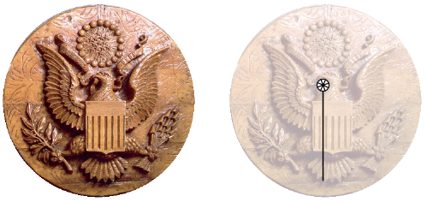
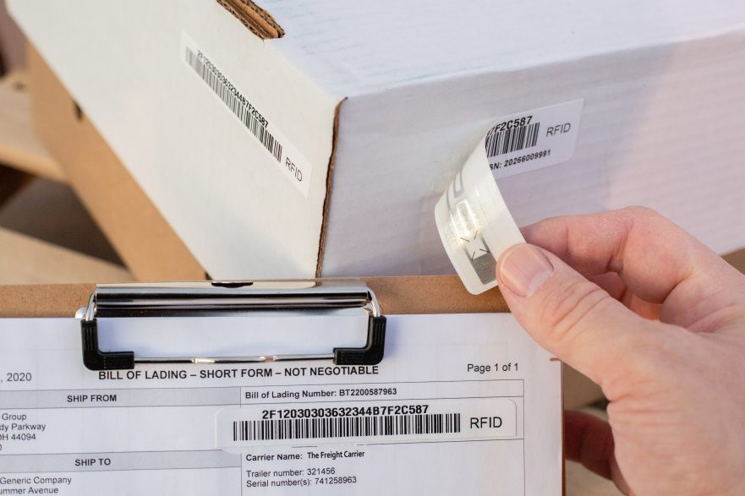
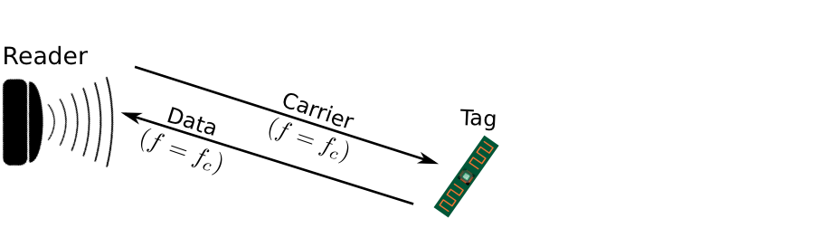
Backscatter is not a new transmission mechanism
First backscatter system: Great seal bug (The Thing) 1945
RFIDs: one of the most widely deployed backscatter system
Great Seal Bug (Backscatter device embedded for spying)
RFID System

Slide 8
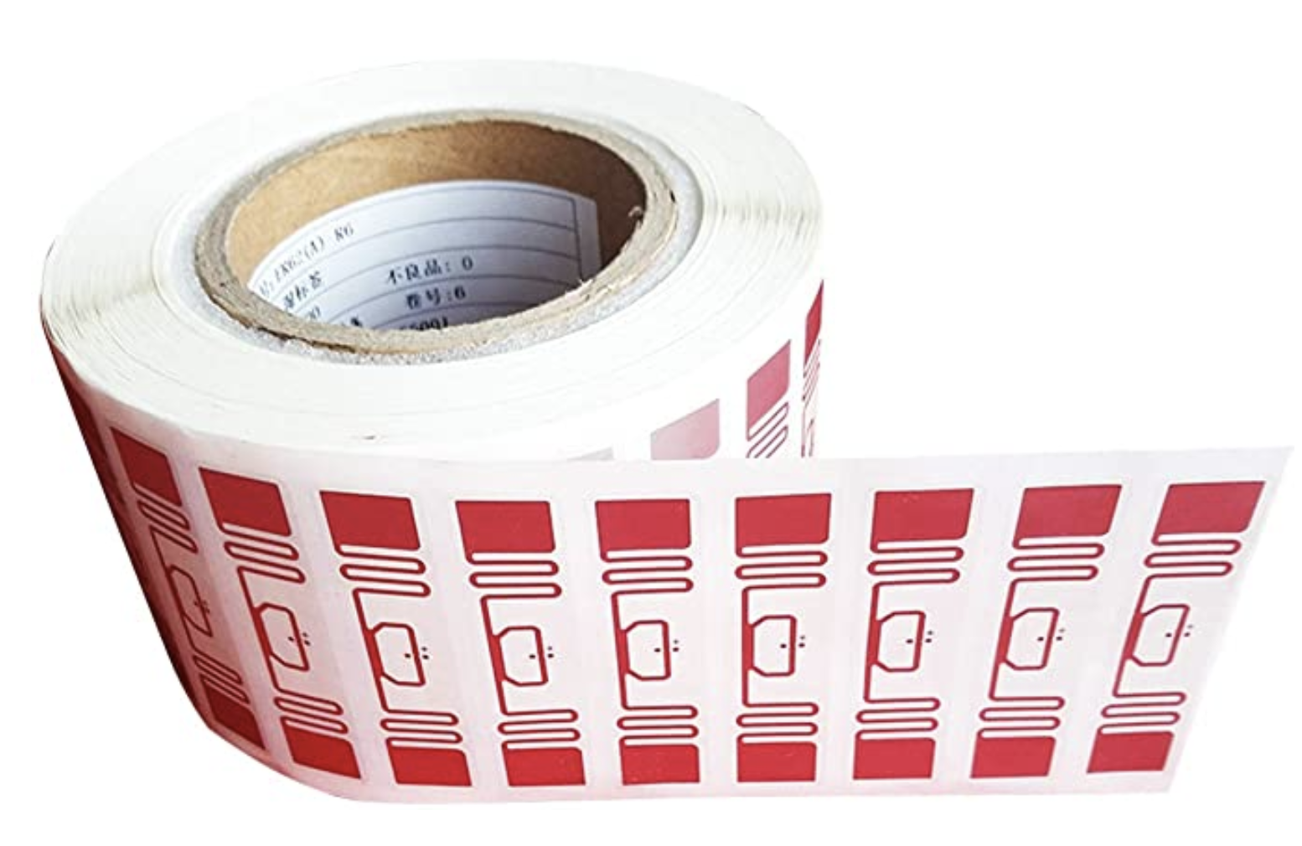
RFID is everywhere nowadays
Fundamental design principle is asymmetry
Extremely simple, cheap tags
Complex readers

Slide 9
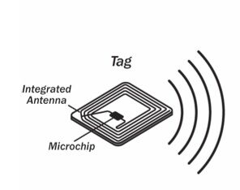
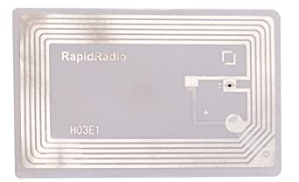
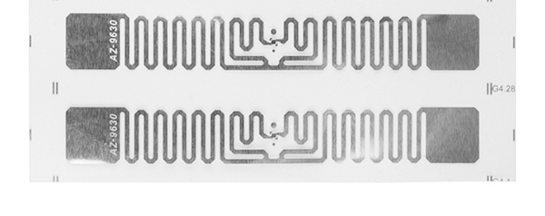
Radio Frequency ID
Cheap, low-power ubiquitous communication
RFID tags on (or in) products
NFC communication to/from smartphone
Requirements
Need to transmit small amount of data (ID)
Need to operate with little or no energy
Most do not have batteries
Short interaction time (fast enough bit rate)
Range can be extremely limited
Meters to centimeters (or millimeters)

Slide 10
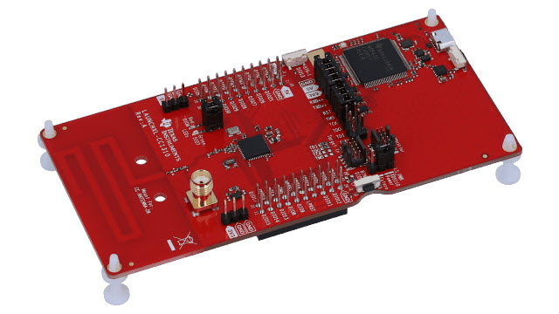
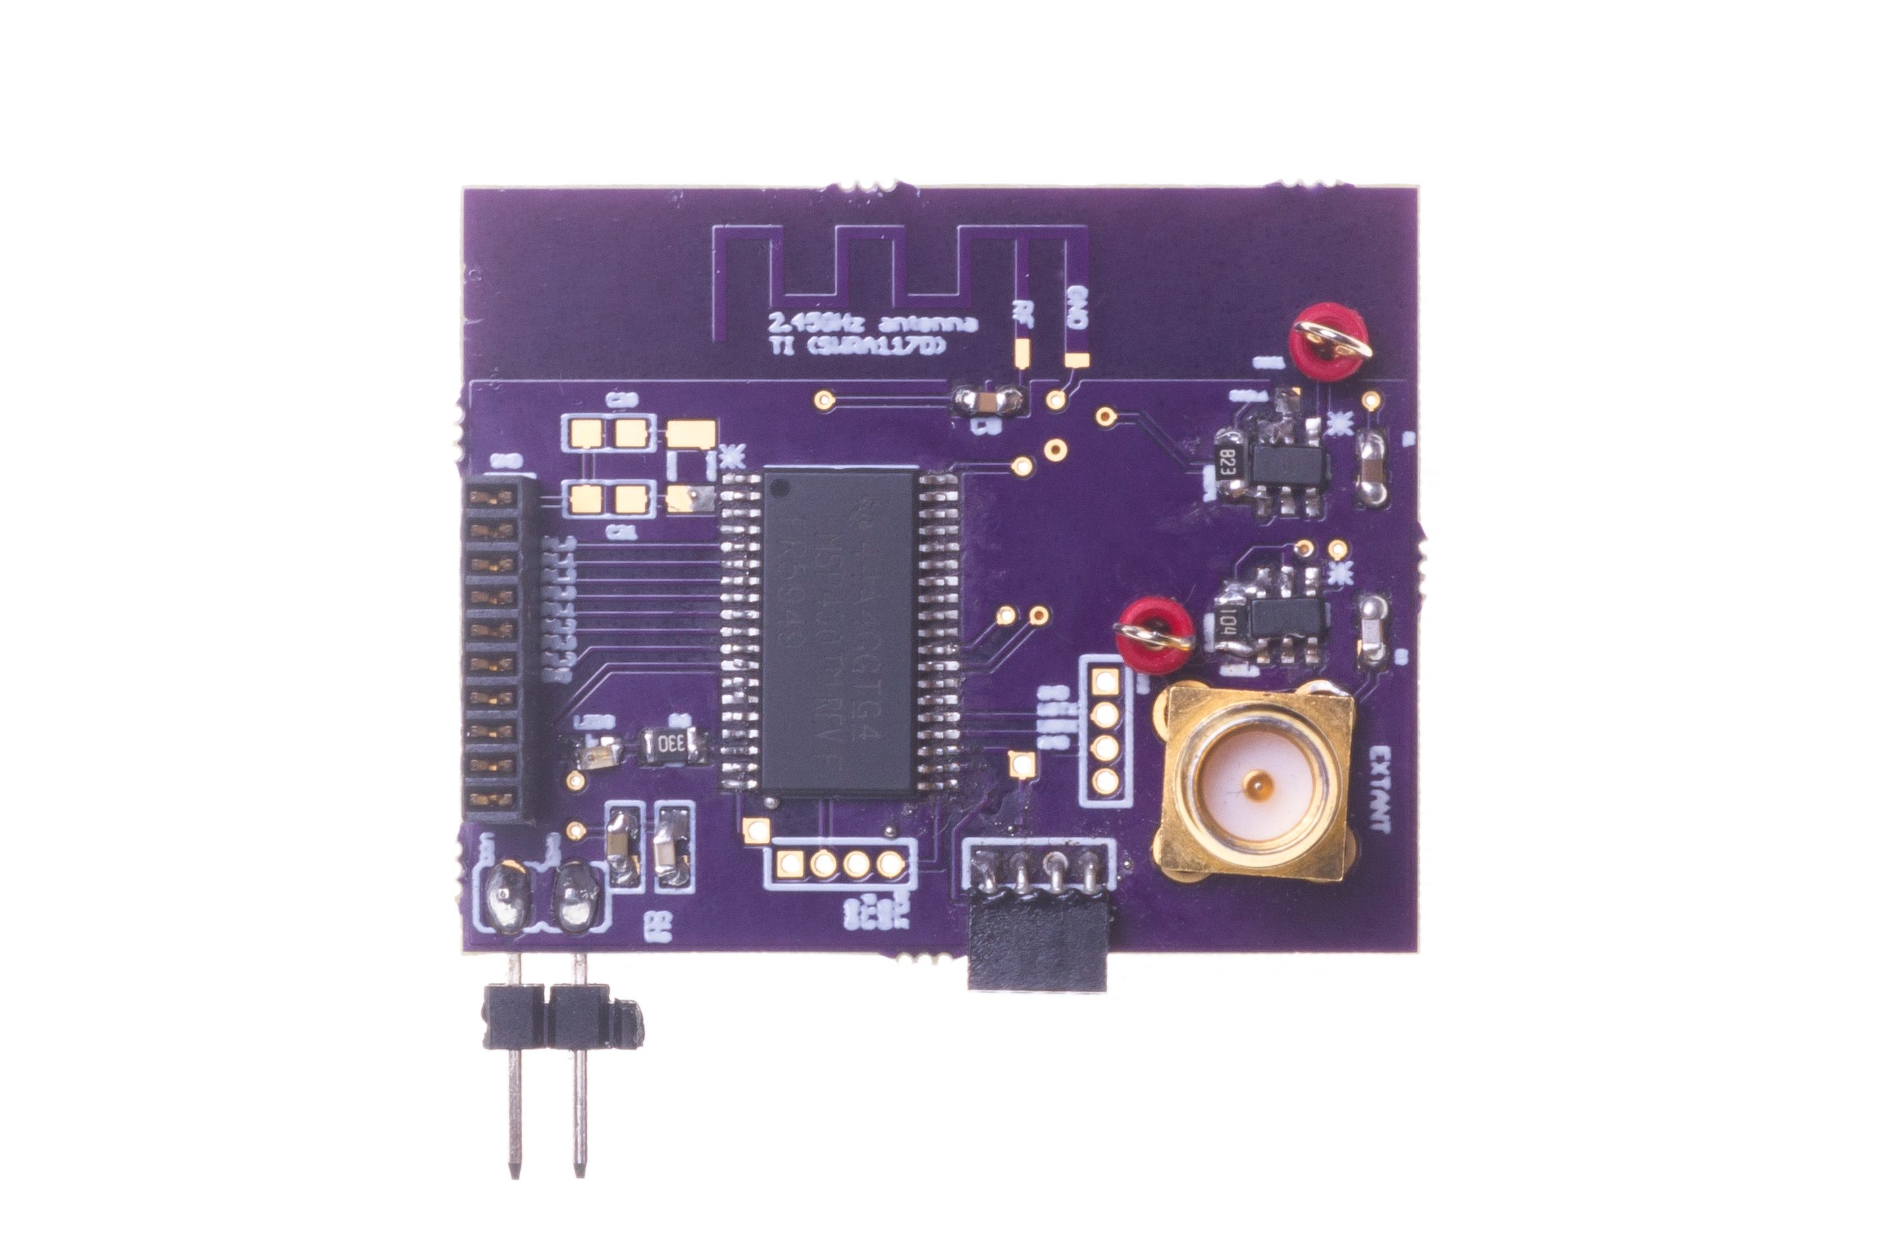
LoRea bridges the energy asymmetry between communication (TX), sensing and processing
Off-the-shelf hardware for transmission and receptions. Tens of USD
Overturn notion that backscatter is a short-range transmission mechanism
Component | Power Consumption
LoRea (Transmissions) | 70 µW (868 MHz)
Conventional Transceiver | Tens to hundreds of mW’s
Microcontroller (Apollo3) | 100s of µW’s
Sensors | Few to tens of µW’s
LoRea transmits at similar power consumption as a sensor
Texas Instruments CC1310 Launchpad: Receiver
Backscatter Tag Hardware Prototype
(Peak Power of 70 µW)
Notes:
+ Thus, with LoRea, we were able to design a backscatter system that was able to overcome the range and cost limitations that had limited all the existing backscatter system, and had hindered the widespread usage of the mechanism on the IoT devices
.
+ In fact, the backscatter tag even though it was designed using off-the-shelf components is orders of magnitude more efficient than commercial transceivers while supporting orders of magnitude lower power consumption.
+ the entire backscatter setup costs just few tens of USDs, which dramatically lowers the cost of infrastructure required to support the backscatter tags and carrier emitter device.

Slide 11
What is the expected lifespan of a battery?
Coin cell (CR2032): 240 mAh, Flexible battery (Molex): 10 mAh
Backscatter transmitter: (LoRea, SENSYS 2017) – 35 uA
Let’s estimate long would battery last under different device load:
Component | Current draw | Flexible Battery | Coin cell
Microcontroller | 200 uA | 50 h | 1200 h
Accelerometer | 10 uA | 1000 h | 24000
WiFi Transmitter | 15 mA | 45 mins | 16 h
Bluetooth Transmitter | 1 mA | 10 h | 240 h
Backscatter Transmitter | 35 uA | 285.7 h | 6857 h

Slide 12
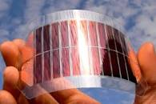
What's next? Embedded systems on harvested energy
𝜇W
Energy harvester
Microwatts of power available to harvest from ambient sources
Notes:
++ The high-power consumption for the IoT platforms also blocks an important and promising direction to enable the sustainable deployment of large-scale embedded devices. This is to eliminate batteries from these platforms altogether. If we eliminate batteries, how do we power these devices?
++We use the fact that ambient energy sources surround us. We are constantly bombarded with radio frequency transmissions such as television, wifi, radio signals, or we have waste heat energy sources, or the indoor light is ubiquitous. All these sources could be harvested to derive energy to power the IoT devices and platforms and eliminate the overhead associated with batteries on these platforms. However, the challenge that we encounter is that we could only derive microwatts of power from these ambient sources, which is sufficient to power the sensors and microcontrollers. However, we need orders of magnitude higher power for operating radio transceivers such as LoRa. This makes it challenging, if not impossible, to power sensors through energy derived from the environment.

Slide 13
Embedded systems on harvested energy
Batteries/Capacitors can potentially be recharged by environmental effects
Some examples
Solar : solar cell
Wind: micro wind turbine can be used to harvest wind energy readily available in the environment in the form of kinetic
Thermal: capture energy from industrial equipment, structures, and even the human body.
Vibration: vibration from engines can stimulate piezoelectric materials, as can the heel of a shoe.
Kinetic: translate movement to change in electromagnetic flux
Radio Frequency (RF): convert ambient RF signal into energy (demo video)

Slide 14
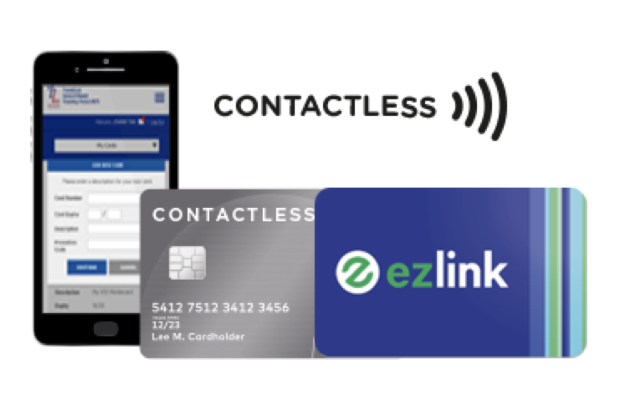
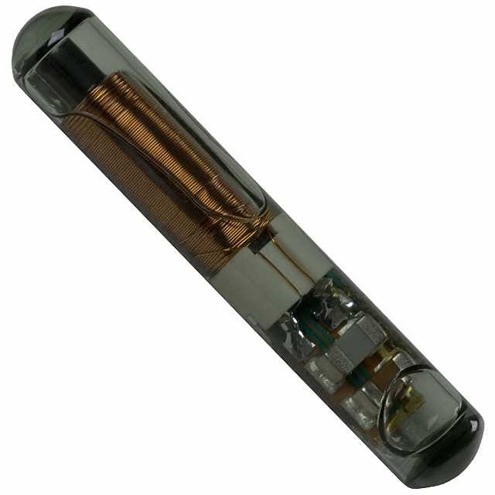
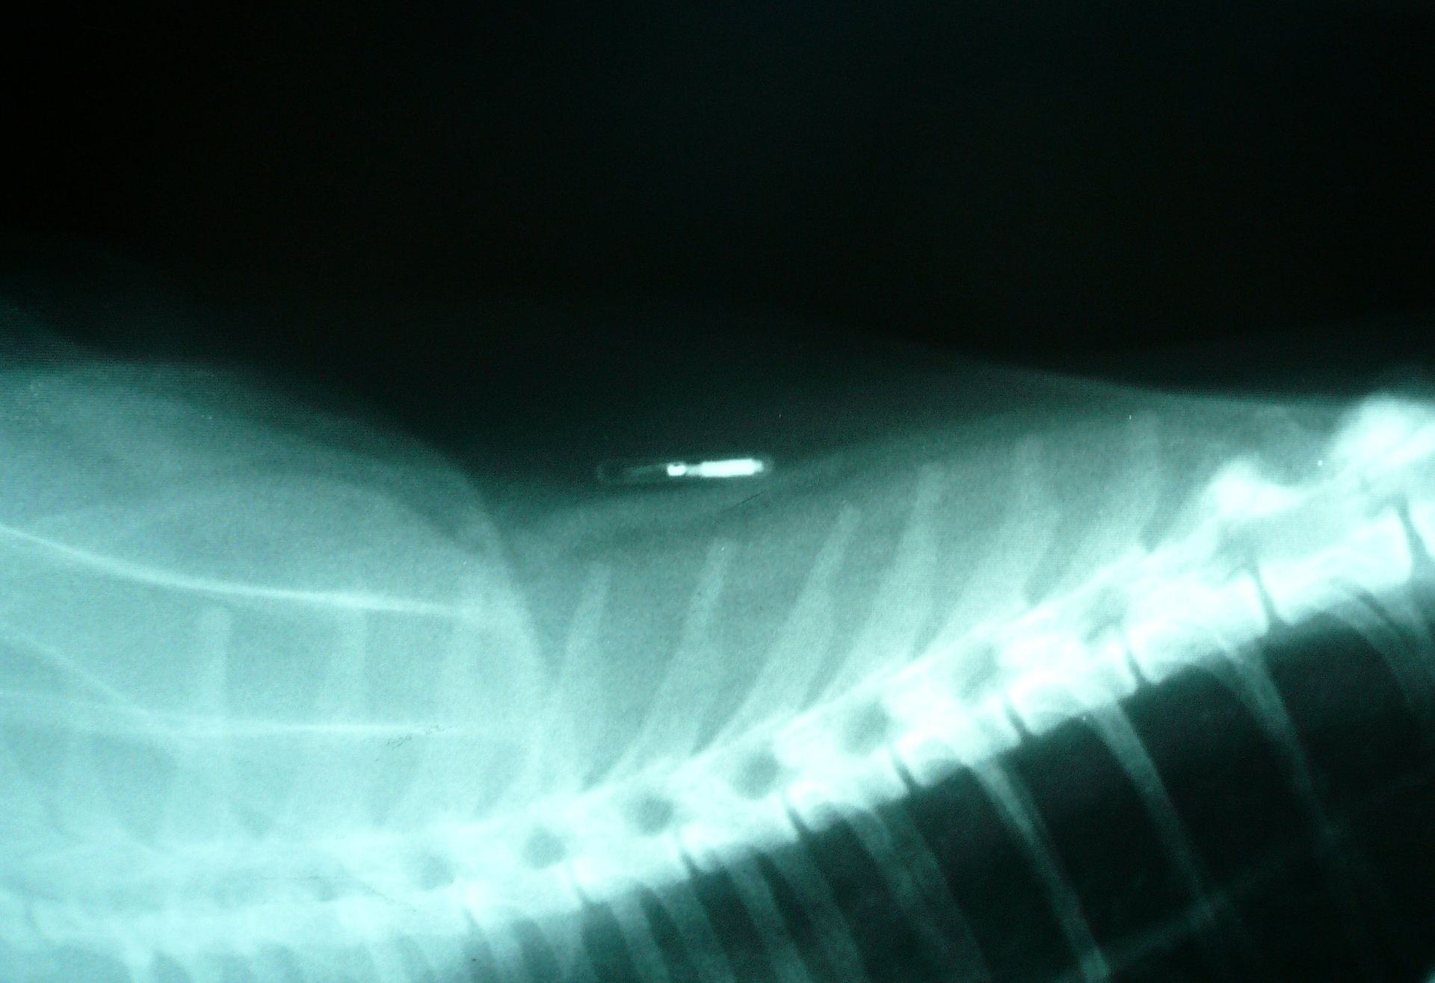
What communication modality do these use?

Slide 15
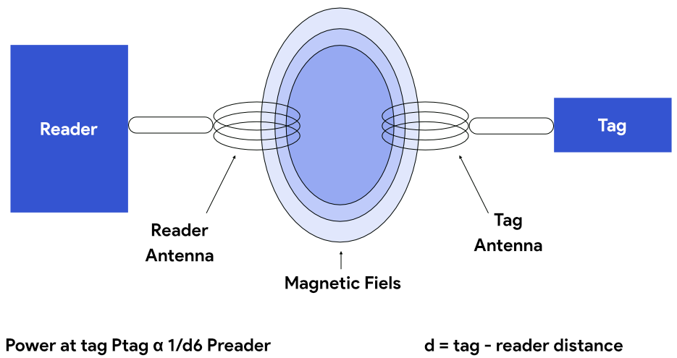
Communication using inductive coupling
A shared magnetic field is created between the two devices
Change in current through one device induces current change through the other
Device can vary load to transmit data
Very low frequency bands (135 KHz, 13.56 MHz)
Transmit through materials including skin
Sensitive to metal

Slide 16
Near Field Communication (NFC)
Inductive Coupling concept (13.56 MHz)
But attached to a powered and capable device (smartphone)
10-20 cm range max (usually <10)
Can act as a tag or as a reader
Allows smartphone to power a tag if needed
Alternatively, smartphone could act like a card and respond to a reader
Two smartphones can communicate without power transfer
Data rate 100-400 kbps!
nRF52840 capable of 100 kbps communication with attached antenna

Slide 17
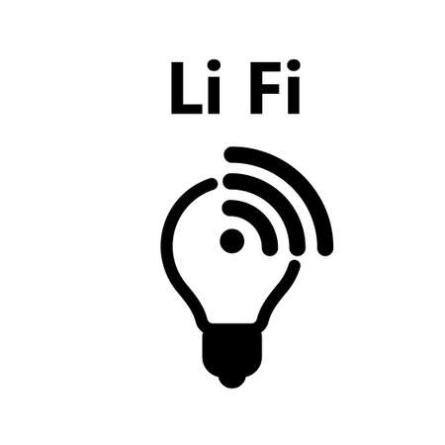

Light Fidelity (LiFi) for Internet of Things
00100111
0
0
1
1
0
0
1
Light-fidelity
1
Advantages:
Illumination
Energy
Communication
Notes:
Let’s start the background story from LiFi
Light fidelity is a wireless technology that uses visible light for data transmission. The information is modulated on the light signal according to the baseband signal.
LiFi offers advantages, such as using a different part of the specturm other than crowded RF electromagnetic signal
In addtion, it simultaneously provide, illumination, energy and communication
Which makes it a good candidate for IoT connectivity.

Slide 18

LiFi communication suffers from coverage challenges
Light cannot propagate through walls or other such physical boundaries
Great from privacy perspective, but limits deployable location of IoT devices
Many IoT devices are located in places with very poor light propagation
IoT devices that are located in the air vents
Inside the wall, floor and other surfaces
IoT devices that are embedded inside the human body
Notes:
Light signal can not propagate through physical spaces. Things like walls, floors, metals block light signal.
When considering privacy, this is an advantage. However for IoT applications, it limits the scenarios where sensors located in places with poor light propagation.

Slide 19
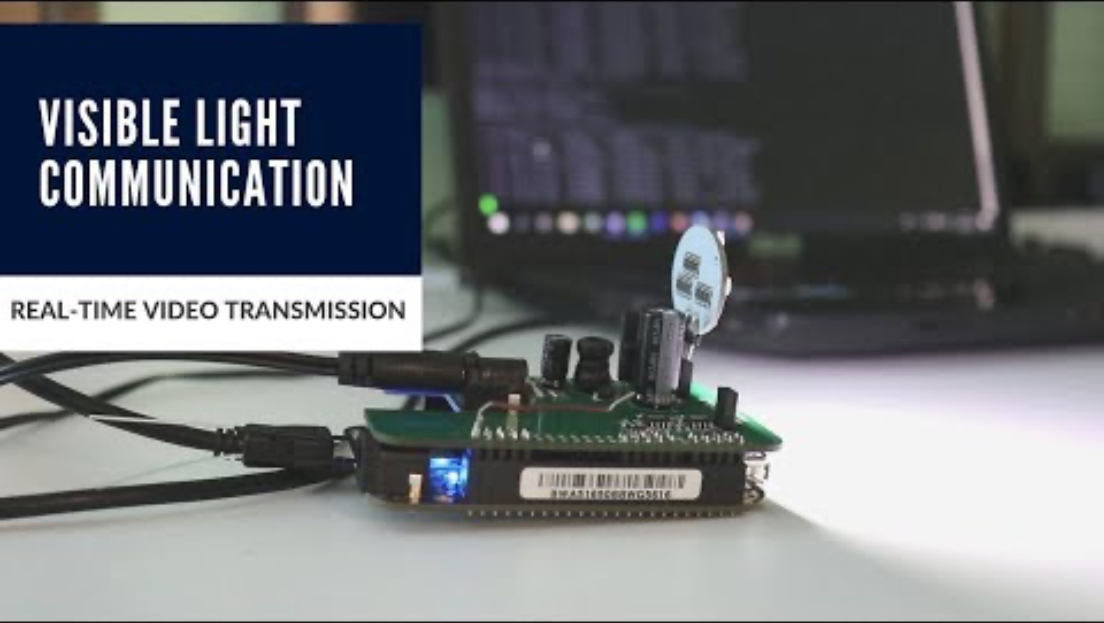
Example of LiFi communication from a collaborator
Notes:
Light signal can not propagate through physical spaces. Things like walls, floors, metals block light signal.
When considering privacy, this is an advantage. However for IoT applications, it limits the scenarios where sensors located in places with poor light propagation.

Slide 20
Roadmap of the lecture today
General course information and updates
Let us review what we had covered the last lecture
Communication layers and need for medium access control
MAC: Channelization protocols
MAC: Random access protocols
Medium access control for internet of things
Notes:
Here is the roadmap of the major topics that I am going to cover during the presentation. We have already covered the exponential growth of the internet of things; next, I will talk about the critical energy challenge that can severely hinder this massive growth and preventing us from realising this immense economic value enabled by the IoT.

Slide 21
Communication Layers
Notes:
++ Over the past few years, I have designed several backscatter and beyond backscatter systems that precisely overcome these critical challenges that have limited the widespread deployment of backscatter on IoT devices.
++ The research vision that I have pursued and would like to pursue as a faculty member is to enable a massive deployment of IoT devices by bridging the energy asymmetry between sensing, computation and communication blocks by designing novel platforms and communication mechanisms. I am going to describe some of my research contributions next.

Slide 22
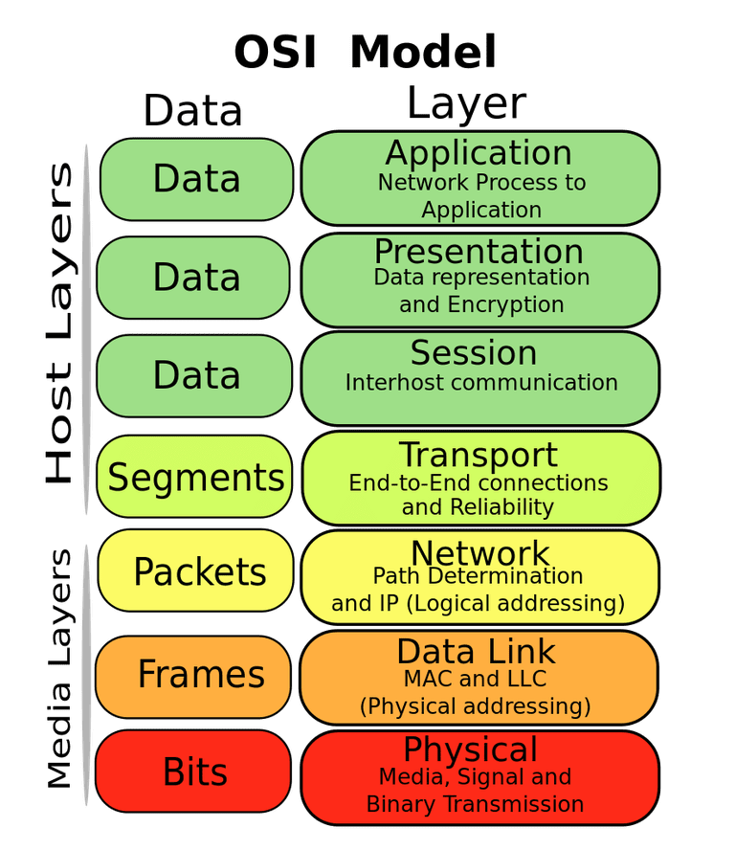
OSI model of communication layers
Transport
How to form connections between computers
TCP and UDP
Network
How to send packets between networks
IP
Data Link
How to send frames of data
Ethernet, WiFi
Physical
How to send individual bits
Ethernet, WiFi

Slide 23
Protocols are “layered”
Headers for each layer of communication wraps data
Data is wrapped with header for the network to make a packet
Packet is wrapped with header for the link to make a frame
Internet Packet
Data
Packet Header
Frame Header
Ethernet Frame

Slide 24
Data Link Layer
Framing
Combine arbitrary bits into a “packet” of data
Logical link control
Manage transfer between transmitter and receiver
Error detection and correction
Media access
Controlling which device gets to transmit next
Inherently coupled to PHY and its decisions

Slide 25
Framing
Typical packet structure
Preamble - Existence of packet and synchronization of clocks
Header - Addresses, Type, Length
Data - Payload plus higher layer headers (e.g. IP packet)
Trailer - Padding, CRC
Wireless considerations
Control information for Physical Layer
Ensure robustness for header
Explicit multi-hop routing
Possibly different data rates for different parts of packet
Preamble | Destination Address | Source Address | Type and Length | Data | CRC

Slide 26
Error control: detection and recovery
Detection: only detect errors
Make sure corrupted packets get discarded
Cyclical Redundancy Checks
Detect single bit errors
Detect “burst” errors of several contiguous bits
Recovery: also try to recover from small bit errors
Forward error correction
Retransmissions
Far more important for wireless because the cost of transmission is higher

Slide 27
Need for Medium Access Control
Notes:
++ Over the past few years, I have designed several backscatter and beyond backscatter systems that precisely overcome these critical challenges that have limited the widespread deployment of backscatter on IoT devices.
++ The research vision that I have pursued and would like to pursue as a faculty member is to enable a massive deployment of IoT devices by bridging the energy asymmetry between sensing, computation and communication blocks by designing novel platforms and communication mechanisms. I am going to describe some of my research contributions next.

Slide 28
What is hard about wireless?
There are no wires!
Wired networks are constant, reliable, and physically isolated
Ethernet has the same throughput minute-to-minute
Bits sent through Ethernet or USB are (usually) received
Wireless networks are variable, error-prone, and shared
WiFi throughput changes based on location and walls
Signals from nearby devices interfere with your signals
Individual bits might flip or never be heard at all

Slide 29
Wireless is a shared medium
Wired communication has signals confined to a conductor
Copper or fiber
Guides energy to destination
Protects signal from interference
Wireless communication is inherently broadcast in nature
Energy is distributed in space
Signals must compete with other signals in same frequency band

Slide 30
Increasing network capacity is challenging
Wired networks just add more wires
Buses are many signals in parallel to send more data
Wireless networks are harder
Adding more links increases interference
Need to expand to different frequencies

Slide 31
Wired vs. Wireless
Key difference between wired and wireless is the need to support multiple access as wireless is broadcast in nature
How does a network determine which transmitter gets to transmit?
Remember: the wireless medium is inherently broadcast
Two simultaneous transmitters may lose both packets

Slide 32
Analogy: wireless medium as acoustic
How do we determine who gets to speak?
Two simultaneous speakers also lose both “transmissions”
Eye contact (or raise hand) -> out-of-band communication
Wait until it’s quiet for some time -> carrier sense multiple access
Strict turn order -> time division multiple access
Just speak and hope it works -> ALOHA
Everybody sing at different tones -> frequency division multiple access (stretching the metaphor)

Slide 33
Wireless: What are challenges of multiple access
Problem: Multiple radio transmitters want to access a common channel
How to coordinate access for these radio transmitters ?

Slide 34
What can be mechanisms for multiple access
How to enable multiple devices to communicate over shared channel?
Avoid or reduce collisions
Detect collisions (less common in wireless)
Decide when to retransmit

Slide 35
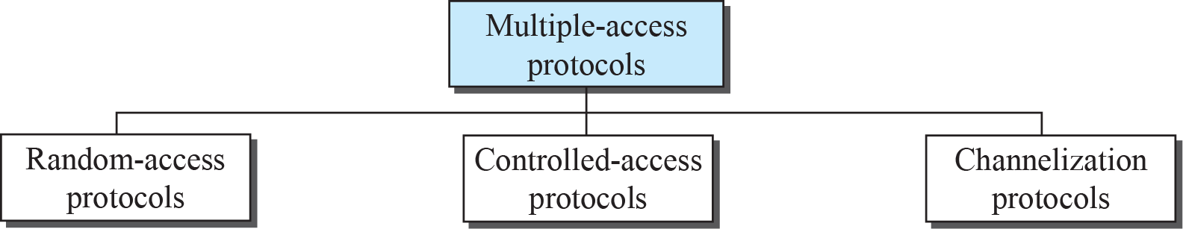
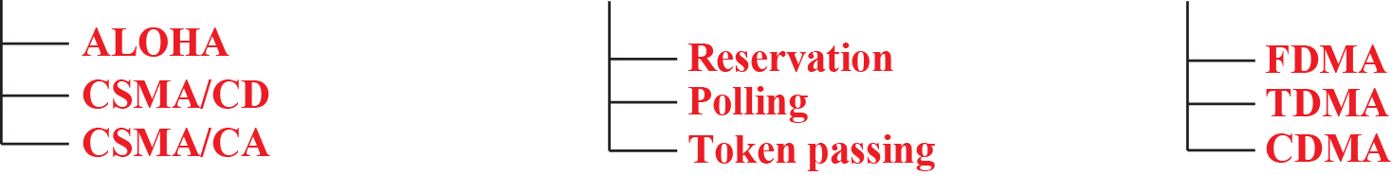
Taxonomy of multiple-access protocols
Reduce collision,
“manage” retransmission
Avoid collision

Slide 36
Roadmap of the lecture today
General course information and updates
Let us review what we had covered the last lecture
Communication layers and need for medium access control
MAC: Channelization protocols
MAC: Random access protocols
Medium access control for internet of things
Notes:
Here is the roadmap of the major topics that I am going to cover during the presentation. We have already covered the exponential growth of the internet of things; next, I will talk about the critical energy challenge that can severely hinder this massive growth and preventing us from realising this immense economic value enabled by the IoT.

Slide 37
Channelization Protocols

Slide 38
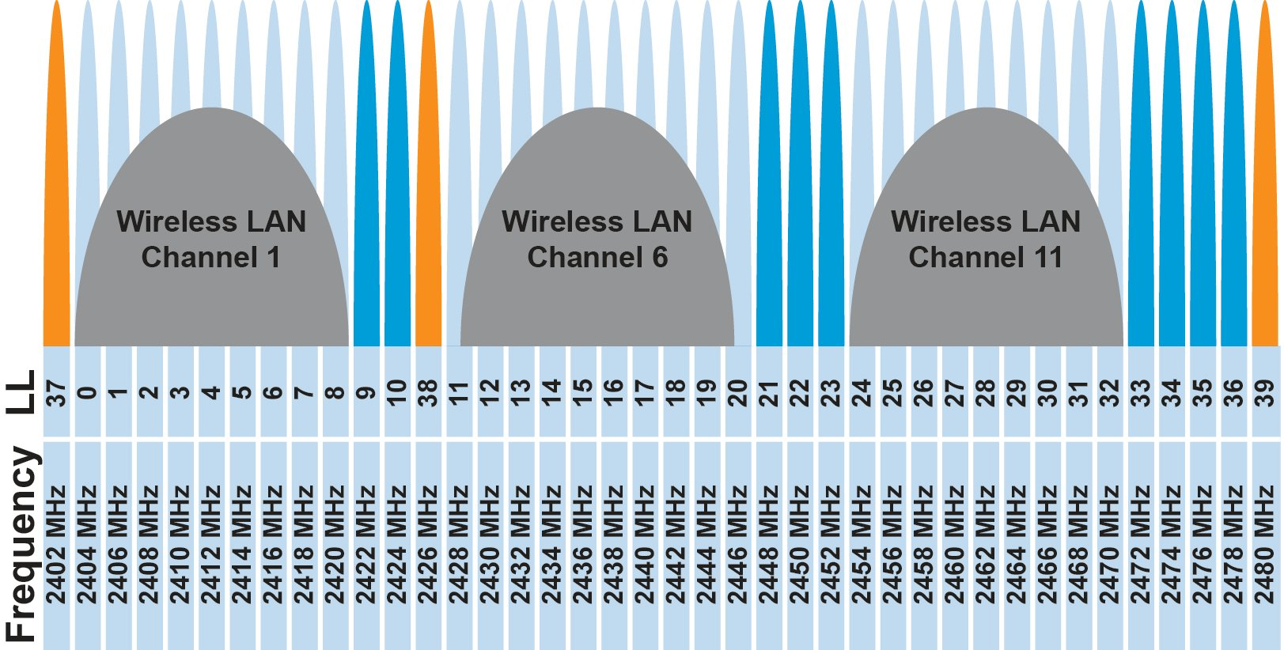
FDMA – Frequency Division Multiple Access
Separate transmissions by placing them at different frequencies
Channel:
Technically, each device can use a separate, fixed frequency
One example can be walkie-talkies
What are disadvantages of giving every device own frequency?
Conceptually, how RF channels work
WiFi networks pick different bands
802.15.4 picks a channel to communicate on

Slide 39
FDMA – Frequency Division Multiple Access
Separate wireless transmissions by placing them at different frequencies
Channel:
Technically, each device can use a separate, fixed frequency
One example can be walkie-talkies (mostly separate)
What are disadvantages of giving every device own frequency?

Slide 40
Wireless communication over multiple channels
Why do we need multiple channel for wireless communication?
Increase throughput
spatial diversity
Increase reliability

Slide 41
Multi Channel MAC Protocols
Use a control channel:
Use of a default channel and time synchronization for control message exchange
Nodes switch to a different channel for data communication
All channels are used for data communication:
Nodes switches to another channel when link quality is bad
How do we find a “good” channel to switch to?

Slide 42
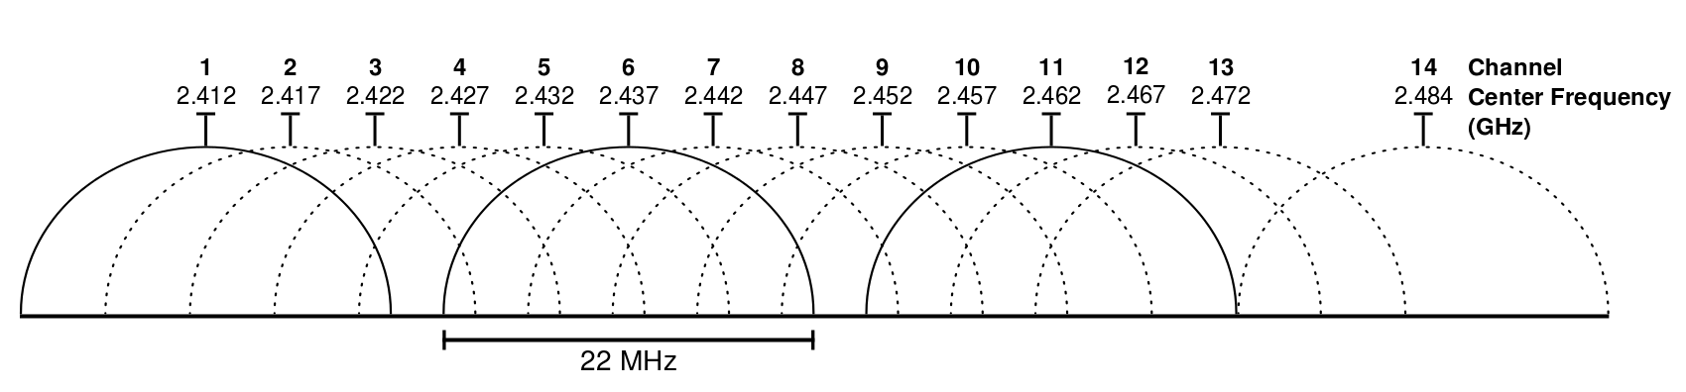
Wifi Channels
14 channels designated in the 2.4 GHz range spaced 5 MHz apart (with the exception of a 12 MHz spacing before channel 14)
https://en.wikipedia.org/wiki/List_of_WLAN_channels

Slide 43
ZigBee Channels

Slide 44
TDMA – Time Division Multiple Access
Split transmissions in time
Devices share the same channel
Splits time into fixed-length windows
Each device is assigned one or more windows
Can build a priority system here with uneven split among devices
Requires synchronization between devices
Often devices must listen periodically to resynchronize
Less efficient use of slots reduce synchronization
Large guard windows. E.g. 1.5 second slot for a 1 second transmission

Slide 45
TDMA: Time Division Multiple Access‏
Consider a 1Mbps channel (1,000,000bits/sec)
Divide channel into 1000 (equal) times slots
Each slot is 1ms, and can transmit 1,000 bits
Assign slots to 50 users
Each user transmits every 50 slots/ms and transmit 20 times/slots per second
On average, each user can transmit 20kbps
Buffering is needed on both sender and receiver to match the differences in data rates
sender-side: 20kbps -> 1 Mbps
Receiver-side: 1Mbps -> 20kbps
Notes:
45
45

Slide 46
TDMA vs. FDMA
FDMA
TDMA
Frequency
Frequency
Time
Time
In practical systems, TDMA is often combined with FDMA
Frequency
Time
Notes:
46
46

Slide 47
Orthogonal Frequency Division Multiplexing :OFDM
In FDM, the entire frequency spectrum is dedicated to carry data from a single source
Example: transmit at 40Mbps over a 20 MHz spectrum
In OFDM, data is divided into many (slower) bit streams and multiple subcarriers (each with smaller spectrum) is used
Example: divide data source into 40 sources, each 1Mbps

Slide 48
TSCH Network
Time is divided into slots, multiple slots form a slotframe
Sends to receiver on slots it is listening on (e.g. green to C, red to A)
Frequency chosen for a timeslot is based on a pseudo-random pattern
Scheduling policy is not standardized

Slide 49
Frequency and Time leads to Spread Spectrum (SS)
Spread-spectrum techniques are methods by which a signal is deliberately spread in the frequency domain, resulting in a signal with a wider bandwidth
Such techniques can be used to establish secure communications, increase resistance to natural interference, jamming and to prevent detection
Concept has been alluded to in 1900s, and applied in some form during WWII
Resistant to narrowband interference
Signals are difficult to interpret – appears as if increase in background noise
Can share frequency band with others with minimal interference

Slide 50
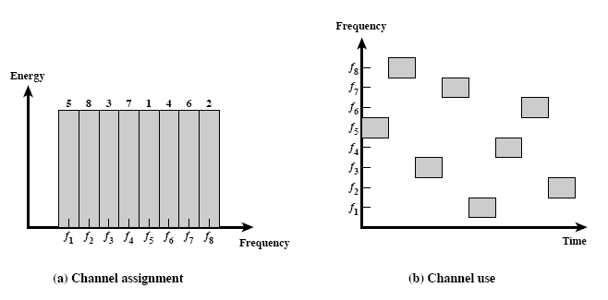
Spread spectrum: Frequency Hopping (FH)
FHSS increase resistance to a) natural interference b) jamming c) detection

Slide 51
Spread spectrum: Frequency Hopping (FH)
A protocol that we use everyday uses Frequency hopping spread spectrum technique?

Slide 52
Spread spectrum: Frequency Hopping (FH)
A protocol that we use everyday uses Frequency hopping spread spectrum technique?
Bluetooth hops between 79 different 1 MHz channels in the band.

Slide 53
WiFi Channel Usage

Slide 54
Cross Channel Interference (CTI)
A. Hithnawi, et.al.,TIIM: Technology-Independent Interference Mitigation for Low-power Wireless Networks, IPSN 2015

Slide 55
Break! (5 minutes)
Notes:
++ Over the past few years, I have designed several backscatter and beyond backscatter systems that precisely overcome these critical challenges that have limited the widespread deployment of backscatter on IoT devices.
++ The research vision that I have pursued and would like to pursue as a faculty member is to enable a massive deployment of IoT devices by bridging the energy asymmetry between sensing, computation and communication blocks by designing novel platforms and communication mechanisms. I am going to describe some of my research contributions next.

Slide 56
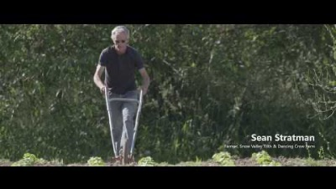
Farmbeats (TV Whitespace) (Courtesy: Microsoft)

Slide 57
One of the last year’s question
Question: You are deploying IoT devices in farms to help increase agricultural yield. These IoT devices would monitor soil humidity and temperature, and then transmit this sensor information to a base station that is deployed in the center of the field. The base station is located several hundred meters away from the IoT devices. In this deployment, you plan to use TV whitespace for communication. You can assume that there is no synchronization between IoT devices. Television stations operate at frequency between 500 to 700 MHz.

Slide 58
One of the last year’s question
What are the frequency bands that are available for communication with the IoT device? (2 point)
Television Station | Frequency band
A | 500-508 MHz
B | 520-528 MHz
C | 540-548 MHz
D | 560-568 MHz
E | 580-588 MHz
Reserved | 620 MHz onwards

Slide 59
One of the last year’s question
What are the frequency bands that are available for communication with the IoT device? (2 point)
Television Station | Frequency band
A | 500-508 MHz
B | 520-528 MHz
C | 540-548 MHz
D | 560-568 MHz
E | 580-588 MHz
Reserved | 620 MHz onwards
Answer: a)
508-520 MHz
528-540 MHz
548-560 MHz
568-580 MHz
588-620 MHz

Slide 60
One of the last year’s question
What are the frequency bands that are available for communication with the IoT device? (2 point)
Television Station | Frequency band
A | 500-508 MHz
B | 520-528 MHz
C | 540-548 MHz
D | 560-568 MHz
E | 580-588 MHz
Reserved | 620 MHz onwards
Answer: a)
508-520 MHz
528-540 MHz
548-560 MHz
568-580 MHz
588-620 MHz

Slide 61
One of the last year’s question
b) If each of the IoT device requires 500 KHz of bandwidth for communication, how many such concurrently transmitting IoT devices can be supported at the base station? Please justify your answer and mention assumptions made while performing this calculation. (2 point)
Television Station | Frequency band
A | 500-508 MHz
B | 520-528 MHz
C | 540-548 MHz
D | 560-568 MHz
E | 580-588 MHz
Reserved | 620 MHz onwards

Slide 62
One of the last year’s question
b) If each of the IoT device requires 500 KHz of bandwidth for communication, how many such concurrently transmitting IoT devices can be supported at the base station? Please justify your answer and mention assumptions made while performing this calculation. (2 point)
Television Station | Frequency band
A | 500-508 MHz
B | 520-528 MHz
C | 540-548 MHz
D | 560-568 MHz
E | 580-588 MHz
Reserved | 620 MHz onwards
Available bandwidth = (520-508) + (540-528) + (560-548) + (580-568) + (620 - 588) = 12 + 12 + 12 + 12 + 32 = 80 MHz
Each IoT device requires 500 KHz of bandwidth.
Number of devices = Total available bandwidth / Bandwidth per device
= 80 MHz / 0.5 MHz = 160 devices
Assuming all devices operate in non-overlapping frequency bands, up to 160 concurrently transmitting IoT devices can be supported at the base station.

Slide 63
One of the last year’s question
c) What would be the medium access control mechanism and modulation scheme that you would like to use in this deployment? (1 point)
d) If you were to design a custom protocol for communication between IoT devices and the base station, how would you structure the packet? Describe the various fields, their sizes, and any other relevant information. (1 point)

Slide 64
One of the last year’s question
c) What would be the medium access control mechanism and modulation scheme that you would like to use in this deployment? (1 point)
d) If you were to design a custom protocol for communication between IoT devices and the base station, how would you structure the packet? Describe the various fields, their sizes, and any other relevant information. (1 point)
c) We would like to use modulation scheme that enables sufficiently large range at low power. Modulation scheme such as FSK, Lora with CSS. We would use simple medium access control mechanism such as Aloha.
One example:
Preamble (8 bits), Packet Length (8 bits), Device ID (16 bits), Timestamp (32 bits), Soil Humidity (16 bits), Soil Temperature (16 bits), Battery Level (8 bits), CRC (16 bits)

Slide 65
Roadmap of the lecture today
General course information and updates
Let us review what we had covered the last lecture
Communication layers and need for medium access control
MAC: Channelization protocols
MAC: Random access protocols
Medium access control for internet of things
Notes:
Here is the roadmap of the major topics that I am going to cover during the presentation. We have already covered the exponential growth of the internet of things; next, I will talk about the critical energy challenge that can severely hinder this massive growth and preventing us from realising this immense economic value enabled by the IoT.

Slide 66
Random Access Protocols

Slide 67
Random access medium access control protocols
No coordination
The simplest: ALOHA
When a node needs to send, it does so.
If it hears an acknowledgment within a given duration, transmission is successful
otherwise, it resends after waiting a random amount of time.
Protocol strength
minimum overhear
achieves low delay if the load is light

Slide 68
ALOHA
ALOHAnet (1971)
University of Hawaii – Norman Abramson
First demonstration of wireless packet network
Rules
If you have data to send, send it
Two (or more) simultaneous transmissions will collide and be lost
Wait a duration of time for an acknowledgement
If transmission was lost, try sending again “later”
Want some kind of exponential backoff scheme here

Slide 69
Packet collisions
Each packet transmission has a window of vulnerability
Twice the on-air duration of a packet
Transmissions during the packet are bad
Transmissions before packet can also be bad

Slide 70
Slotted ALOHA
Split time into synchronized “slots”
Any device can transmit whenever it has data
But it must transmit at the start of a slot
And its transmission cannot be longer than a slot
Removes half of the possibilities for collisions!
At the cost of some synchronization method
time

Slide 71
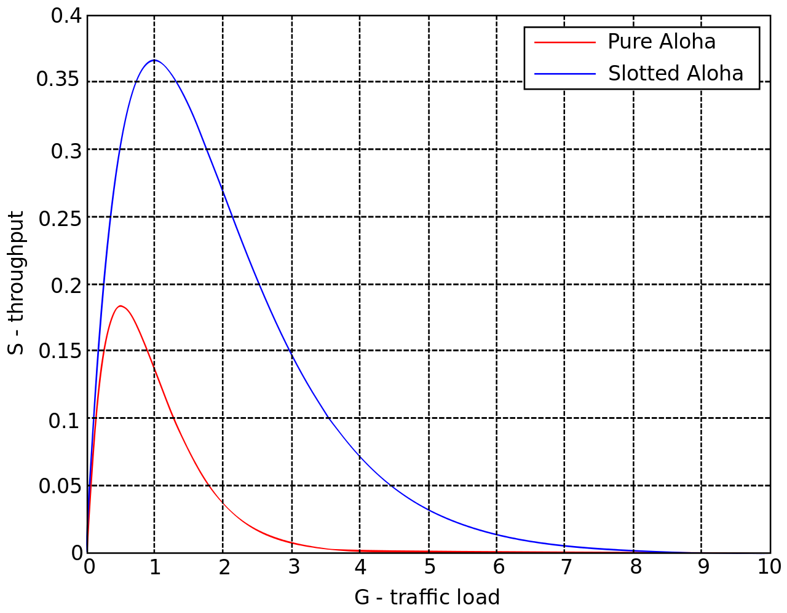
ALOHA throughput
It can be shown that traffic maxes out at
ALOHA: 18.4%
Slotted ALOHA: 36.8%
Assuming Poisson distribution of transmission attempts
Slotted throughput is double because the “before” collisions can no longer occur

Slide 72
Carrier Sense Multiple Access
Carrier Sense Multiple Access:
sense carrier
If idle,
send
wait for ack
If there isn’t one, assume there was a collision, retransmit
Should we transmit immediately once channel is idle?

Slide 73
Carrier Sense Multiple Access/ Collision Avoidance
CA – Collision Avoidance
if the channel is clear, deferred transmission for a "random" interval
Choose interval from a uniform distribution with values between 0 and maximum window size W_{max}
reduces the probability of collisions on the channel
How large should W_{max} be?
If interval is long, time is “wasted” …
If interval is too short?

Slide 74
CSMA/CA: Choosing W_{max}
Should W_{max} be constant?
Intuitively, W_{max} should be small when there is lower chance of collision and vice versa
W_{max} varies according to the Binary Exponential Backoff (BEB) algorithm.
Set “slot time” to 2 times the max. propagation delay on the channel
If this is the first transmission, sends immediately
If there is a collision, after i-th collision, pick W_{max} randomly between 0 and 2^{i}-1 time slots.

Slide 75
CSMA/CA: Trade-off
What are the Trade-off:
More aggressive (smaller W_{max}) – more likely to achieve higher channel utilization, but also more likely to collide
Less aggressive – lower channel utilization, less likely to collide
Utilization vs. delay
Overly aggressive or conservative can increase delay
Optimal point depends on
Number of stations/nodes contenting
Traffic load

Slide 76
Window Size “Tuning”
W_{max} window can be varied to change the share of the bandwidth that are allocated to various mobile nodes
Main idea: station/node with “smaller” W_{max} gets larger share of bandwidth
Problem: find the “right” combinations of window sizes for different nodes

Slide 77
Hidden terminal problem
Device C
Device A
Device B

Slide 78
CSMA with RTS/CTS
Hidden terminal problem means that two transmitters might never be able to detect each other’s transmissions
A partial solution
When channel is idle, transmitter sends a short Request To Send (RTS)
Receiver will send a Clear To Send (CTS) to only one node at a time
RTS collisions are faster and less wasteful than hidden terminal collisions
Downside: overhead is high for waiting for CTS when contention is low

Slide 79
Solving Hidden Terminal Problem
B
RTS
CTS
CTS
A
C
OK, I’ll wait …

Slide 80
Real-world protocol access control
ALOHA
BLE advertisements
Unlicensed LPWANs: Sigfox, LoRaWAN
CSMA
WiFi (slotted, CSMA/CA)
TDMA
BLE connections
Cellular LPWANs: LTE-M and NB-IoT

Slide 81
Roadmap of the lecture today
General course information and updates
Let us review what we had covered the last lecture
Communication layers and need for medium access control
MAC: Channelization protocols
MAC: Random access protocols
Medium access control for internet of things
Notes:
Here is the roadmap of the major topics that I am going to cover during the presentation. We have already covered the exponential growth of the internet of things; next, I will talk about the critical energy challenge that can severely hinder this massive growth and preventing us from realising this immense economic value enabled by the IoT.

Slide 82
Medium Access Control for Internet of Things

Slide 83
Medium access control for Internet of Things
Medium access control for normal wireless devices
Low Latency
High Utilization
Fair (every has chance to communicate)
How about medium access control for internet of things?
Power Consumption should be as small as possible
(Most) sensor applications have low channel utilization
Designing medium access control with energy consideration as priority?

Slide 84
Energy consumption of medium access control
The main sources of energy consumption in any contention-based MAC protocol:
overhearing
control packet overhead
data transmission/reception
idle listening
(1) – (3) occurs only when there is a transmission
(4) occurs even when there is no traffic

Slide 85
“Life Cycle” of MAC Protocols
(4)
(1) – (3)
(4)
(1) – (3)
(4)
(1) – (3)
Less Traffic
(4)
(1 – (3)
(4)
(1) – (3)
Less Traffic
(4)
(4)

Slide 86
Idle listening is energy expensive
Idle listening consumes most of the energy as traffic load decreases
Many measurements have shown that idle listening consumes 50–100% of the energy required for receiving
But if you do not listen to the channel, how do detect events/transmissions?

Slide 87
Duty cycled medium access control protocols
Overhearing or passive listening is very expensive, in particular, if utilization is low
Proposal: Don’t overhear, go to sleep!
Advantage:
Consume very little energy when radio is idle/inactive
Problem:
When to wakeup?
Requirements:
Wakeup schedule must be coordinated
The “right” nodes must wake up at the “right” time

Slide 88
Let's consider Aloha protocol
Consider the simplest MAC protocol – ALOHA
No change to the protocol: when a node wants to transmit, it does
Does it work?
Works when
There is no contention (usually true when utilization is low)
The receiver is listening (may not be true with duty cycle)
How to convert ALOHA to work with duty cycle?

Slide 89
Aloha with Preamble Sampling
Sensing
Sensing
Sensing
Sensing
Receiver
Sender
Preamble
Data
Sensing
Sensing
Sensing
Recv
ACK
Receiver 1
Sensing
Sensing
Receiver 2
(Possible we can miss the preamble and thus data?)

Slide 90
Aloha with Preamble Sampling
Tp
Sender
Preamble
Data
Sensing
Sensing
Sensing
Recv
ACK
Receiver 1
Ts
T_{D}
Each receiver periodically (every Tp) wakes up to check if the channel is busy for a duration of (Ts)
If channel is busy, stays in listening mode until destination of data is known (transmitted), else go back to sleep for a period of (Tp-Ts)
Sender transmits a long preamble (Tp), and then send data packet at the end of the preamble period of packet transmission
Is this protocol energy efficient?

Slide 91
B-MAC: Asynchronous Medium Access Control
B-MAC asynchronous MAC protocol. Based on concept of preamble sampling
Nodes periodically activate their radios to detect signals; remain active upon receiving a packet or go to sleep after a set timeout if no activity is detected
To guarantee packet reception, the preamble duration must be at least as long as the channel sampling rate
Idle listening refers to when nodes check an inactive channel, resulting in unnecessary power usage
The preamble time (Tp) should align with the channel check interval for reception; for instance, a 100ms check requires a minimum 100ms preamble

Slide 92
Improving B-MAC
While the design of B-MAC makes suitable for low power/low duty operations, its performance can be improved
Transmitter:
Is a long (continuous) preamble necessary?
(Potential) Receivers:
Is a long (average) waiting period necessary?

Slide 93
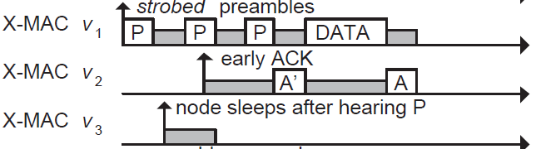
Improving B-MAC with X-MAC
X-MAC improves over B-MAC
Sender transmits many “probes” with gaps between probes. Each probe contains address of intended receiver
Receiver checks address embedded in probe, sends acks if it is the destination during the gap period between probes
Sender transmits DATA, receive replies with Ack to complete data transfer

Slide 94
ContikiMAC
ContikiMAC is the MAC protocol implemented in Contiki OS

Slide 95
Current draw for ContikiMAC

Slide 96
Synchronous MAC
Why not let all nodes wakeup at the same time?
SMAC’s solution
Some form of time division multiplexing
Divide interval into listening and sleeping
Percentage of listening period is the “duty cycle”

Slide 97
Synchronous MAC (SMAC)
Example: 10% duty cycle
Each node listens for 100ms and sleep for 0.9s
Each node listens for 1s and sleeps for 9s

Slide 98
Collisions are always bad?

Slide 99
Receiving transmissions with collisions
Collision does not always lead to packet loss
If a receiver hears from two or more stations and the signal from one station is much stronger than the rest, the receiver can receive the signal correctly “only” from this station: This is called capture effect.

Slide 100
Receiving transmissions with collisions
One receiver, multiple transmitters (transmit same packet)
With capture effect, adding new transmitters may improve reliability!

Slide 101
Receiving transmissions with collisions
99%
15%
35%
100%
R
-70.89dB
T4
-80.93dB
-83.02dB
-84.09dB
T3
T2
T1

Slide 102
Flooding

Slide 103
Flooding is a recreation of broadcasts
Goal: get information to all nodes
This is the problem of “data dissemination”
Problem: difficult in Mesh topologies
Packet loss, retransmission delays
Really, data dissemination is just to broadcast to all nodes
But broadcast transmissions don’t reach far enough to cover entire mesh

Slide 104
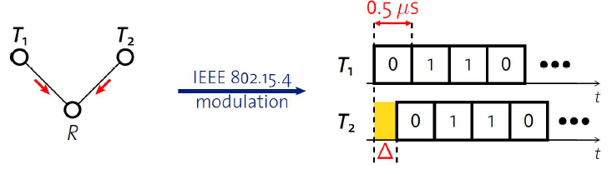
Synchronous transmissions
Multiple nodes transmit same packet at same time
R can receive packet with high probability if Δ is small
May even improve probability of reception (more energy at receiver)
500 ns is 1/32 of a symbol for 802.15.4 (chip duration)

Slide 105
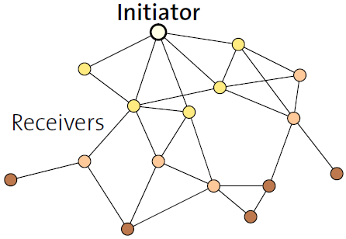
Fast packet propagation in Glossy

Slide 106
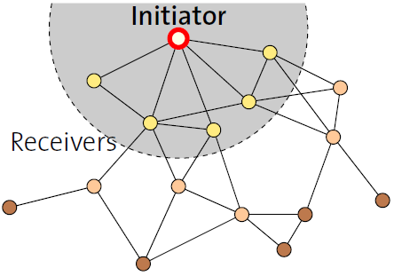
Fast packet propagation in Glossy

Slide 107
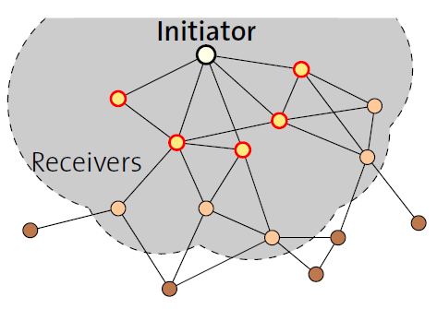
Fast packet propagation in Glossy

Slide 108
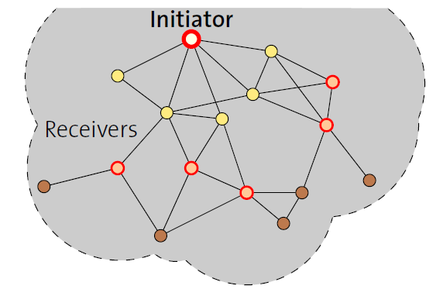
Fast packet propagation in Glossy

Slide 109
Roadmap of the lecture today
General course information and updates
Let us review what we had covered the last lecture
Communication layers and need for medium access control
MAC: Channelization protocols
MAC: Random access protocols
Medium access control for internet of things
Notes:
Here is the roadmap of the major topics that I am going to cover during the presentation. We have already covered the exponential growth of the internet of things; next, I will talk about the critical energy challenge that can severely hinder this massive growth and preventing us from realising this immense economic value enabled by the IoT.

Slide 110
Wireless Networking
Ambuj Varshney
ambujv@nus.edu.sg
Notes:
++ Thank you for inviting me to give this talk
++ In this talk, I will present a pathway that can enable us to make wireless embedded systems ubiquitous. I will describe my previous research efforts that tackle the critical challenges that limit the growth of wireless embedded systems. These are related to the growing energy asymmetry that exists between sensing, computation and communication blocks on these platforms.
++ Finally, I will conclude my talk by covering the research agenda that I would like to work on as a faculty member.

Slide 111
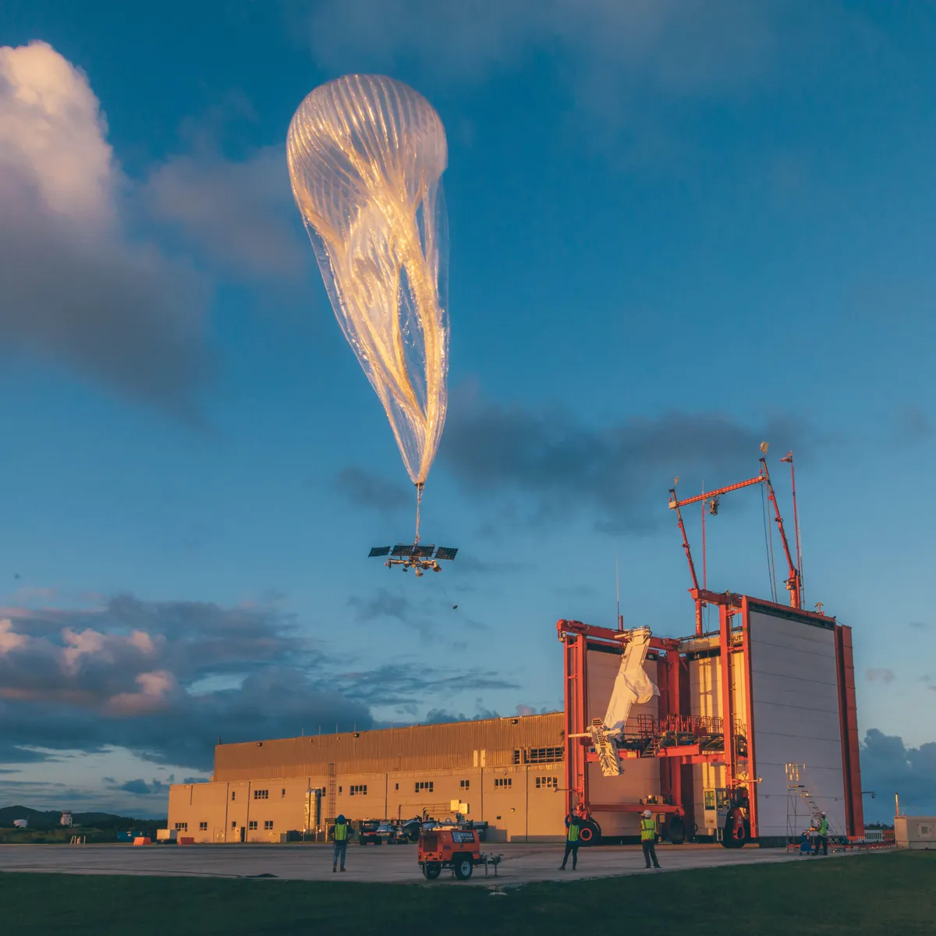
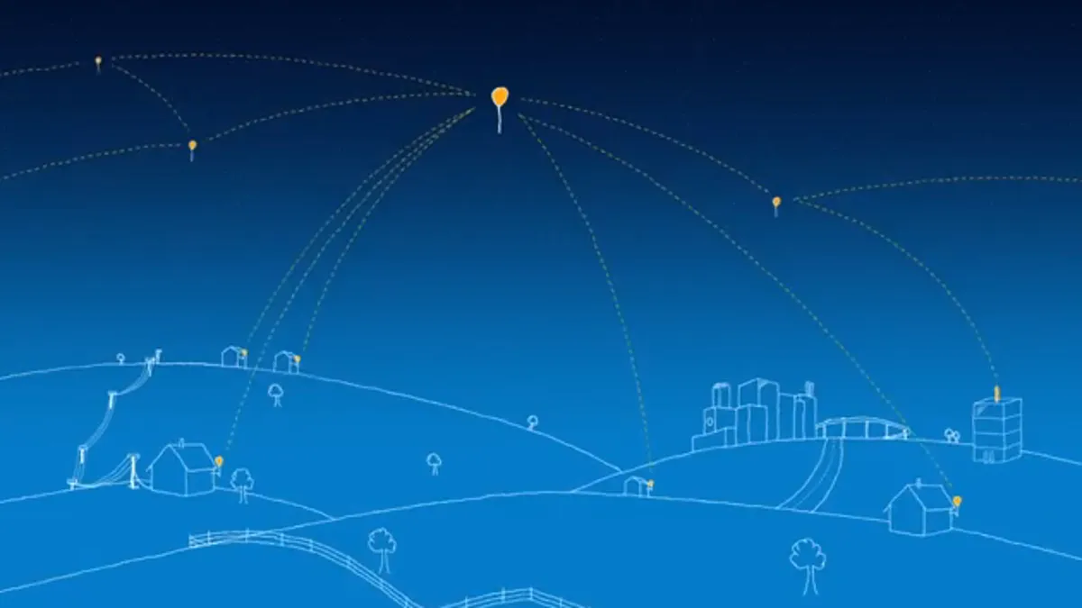
Google Project Loon? Do you know?
Google Project Loon: https://x.company/projects/loon/

Slide 112
One of the last year’s question
Question: Over the past several years, we have seen a growing interest in utilizing satellites to provide wireless connectivity to Internet of Things (IoT) devices. These satellites usually operate at altitudes of 400 to 500 kilometers from the Earth's surface. However, this deployment of satellites has led to concerns regarding orbital congestion and pollution. As an alternative, high-altitude balloons are being explored to provide network connectivity to Internet of things devices. These balloons fly at much lower altitudes of around 20 kilometers from earth’s surface and they offer a very cost-effective solution to satellite launches.

Slide 113
One of the last year’s question
If you are using low-altitude balloons to provide connectivity to ground based IoT devices. Please answer the following questions:
(a) What type of antennas are suitable for use on the high-altitude balloons and ground based IoT devices to ensure reliable communication? Provide appropriate rationale for your choice. (1 point)

Slide 114
One of the last year’s question
If you are using low-altitude balloons to provide connectivity to ground based IoT devices. Please answer the following questions:
(a) Question: What type of antennas are suitable for use on the high-altitude balloons and ground based IoT devices to ensure reliable communication? Provide appropriate rationale for your choice. (1 point)
Balloon: We can use directional antenna such as parabolic antenna to ensure the energy is directed towards the deployment of IoT device.
On IoT devices: Omnidirectional antennas, as it can allow them to receive energy from any direction even if these devices are mobile. It would allow us to avoid positioning the nodes with limited line-of-sight to the balloon.

Slide 115
Are these the only correct answers?
If you are using low-altitude balloons to provide connectivity to ground based IoT devices. Please answer the following questions:
(a) Question: What type of antennas are suitable for use on the high-altitude balloons and ground based IoT devices to ensure reliable communication? Provide appropriate rationale for your choice. (1 point)
Balloon: We can use directional antenna such as parabolic antenna to ensure the energy is directed towards the deployment of IoT device.
On IoT devices: Omnidirectional antennas, as it can allow them to receive energy from any direction even if these devices are mobile. It would allow us to avoid positioning the nodes with limited line-of-sight to the balloon.

Slide 116
One of the last year’s question
If you are using low-altitude balloons to provide connectivity to ground based IoT devices. Please answer the following questions:
(b) Which frequency bands are suitable for communication between balloon and IoT device? Provide appropriate rationale for your choice. (1 point)

Slide 117
One of the last year’s question
If you are using low-altitude balloons to provide connectivity to ground based IoT devices. Please answer the following questions:
(b) Which frequency bands are suitable for communication between balloon and IoT device? Provide appropriate rationale for your choice. (1 point)
Sub-GHz bands due to their superior propagation characteristics. Ideally, we should be looking at ISM frequency bands. For some application, perhaps, 2.4 GHz may also work.

Slide 118
One of the last year’s question
(b) Which frequency bands are suitable for communication between balloon and IoT device? Provide appropriate rationale for your choice. (1 point)
Sub-GHz bands due to their superior propagation characteristics. Ideally, we should be looking at ISM frequency bands. For some application, perhaps, 2.4 GHz may also work.

Slide 119
One of the last year’s question
(c) From a wireless communication perspective, what are two advantages and disadvantages of using balloons for connectivity in IoT devices compared to satellite-based solutions? (2 point)

Slide 120
One of the last year’s question
(c) From a wireless communication perspective, what are two advantages and disadvantages of using balloons for connectivity in IoT devices compared to satellite-based solutions? (2 point)
There can be several advantages:
1. Lower latency owing to lower altitude of the balloon
2. We can use ISM frequency bands due to shorter distances for communication
3. Better signal quality owing to stronger signals
Cons:
1. Limited coverage when compared to satellites, may require several balloons overhead
2. Greater chance of interference with terrestrial and other such transmissions
3. Higher maintenance overhead to replace and maintain balloons

Slide 121
One of the last year’s question
(d) Given that the IoT device is equipped with a radio with a receive sensitivity of -100 dBm and an antenna gain of 2 dB. There is an estimated distance of 20 kilometers between the balloon and the IoT device, and the balloon is equipped with 8 dB antenna. Please calculate the transmit power required at the balloon to ensure successful packet reception at IoT device. Use the frequency selected in part (b) for your calculations. The path loss exponent is 2. (4 point)

Slide 122
One of the last year’s question
(d) Given that the IoT device is equipped with a radio with a receive sensitivity of -100 dBm and an antenna gain of 2 dB. There is an estimated distance of 20 kilometers between the balloon and the IoT device, and the balloon is equipped with 8 dB antenna. Please calculate the transmit power required at the balloon to ensure successful packet reception at IoT device. Use the frequency selected in part (b) for your calculations. The path loss exponent is 2. (4 point)
Homework (and tutorial question next week): We can use Friis propagation equation to estimate the answer. For 900 MHz, around 7 dBm transmitter strength.

Slide 123
One of the last year’s question
(e) In a scenario where communication is limited to only transmission from the IoT device to the balloon, what kind of medium access control mechanism would be suitable for the IoT device? You can assume that IoT device is transmitting humidity and temperature readings. Provide appropriate rationale.

Slide 124
One of the last year’s question
(e) In a scenario where communication is limited to only transmission from the IoT device to the balloon, what kind of medium access control mechanism would be suitable for the IoT device? You can assume that IoT device is transmitting humidity and temperature readings. Provide appropriate rationale.
Due to simplicity simple protocols like Aloha makes sense

Slide 125
Wireless Networking
Ambuj Varshney
ambujv@nus.edu.sg
Notes:
++ Thank you for inviting me to give this talk
++ In this talk, I will present a pathway that can enable us to make wireless embedded systems ubiquitous. I will describe my previous research efforts that tackle the critical challenges that limit the growth of wireless embedded systems. These are related to the growing energy asymmetry that exists between sensing, computation and communication blocks on these platforms.
++ Finally, I will conclude my talk by covering the research agenda that I would like to work on as a faculty member.

